Slide 1
Quick and Efficient Link Quality Estimation in Wireless Sensors Networks
Henry-Joseph Audéoud and Martin Heusse

Slide 2
Outline
INTRODUCTION
BASIC METRICS AND THEIR FLAWS
CLASSIFICATION OF LINKS BASED ON LQI
ENSURE REVERSE DIRECTION QUALITY
CONCLUSION

Slide 3
INTRODUCTION
The authors have used a set of Cortex M3 nodes with IEEE 802.15.4 radios (AT86RF231 radio chip) to experiment with several approaches to link quality estimation.
Started with the observation that our testbed exhibits the same kind of packet delivery ratio variability un function of the distance and the received signal power(RSSI)
In contrast, they have obtained more accurate and smoother varying results by reading LQI (Link Quality Indicator) after packet reception.

Slide 4
INTRODUCTION
Although LQI brings more valuable information, it is still safer to check connectivity in the reverse direction, whereas only a small fraction of the links basically require more effort to assess their reliability.
By classifying suspicious links as weak links, they would be avoided by the routing protocol as long as other options exist.
This classification only requires few packet exchanges and it can be far more stable than ETX that may lead to concentrate the power drain on the node at the head of a marginal link due to retransmissions

Slide 5
BASIC METRICS AND THEIR FLAWS
The hop count is the most basic metric, it simply counts the number of nodes crossed to reach a destination
It has a drawback: the farthest neighbors are also those with which tend to be at the edge of the communication range and thus more lossy

Slide 6
BASIC METRICS AND THEIR FLAWS
The Packet Delivery Ratio (PDR) captures the link quality through its loss rate. Inverting PDR gives the number of transmissions likely needed to get one packet through a link: this is ETX (Expected Transmission Count) metric of RPL.
What ETX does not capture, though, is that it leads to disregard reliable multi-hop routes in favor of concentrating the (re)transmission effort on nodes at the head of lossy links.

Slide 7
CLASSIFICATION OF LINKS BASED ON LQI
The IEEE 802.15.4 standard proposes two ways of assessing the link quality after packet reception, both measured at the physical layer:
  the Radio Signal Strength Indicator (RSSI) that captures the average power of the received signal over eight IEEE 802.15.4 symbols;
  the Link Quality Indicator (LQI) that characterizes if the last packet was “heard” clearly or not.

Slide 8
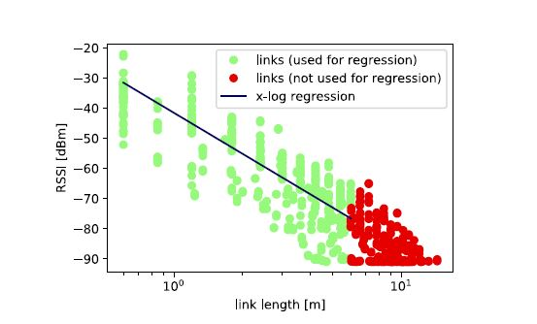
CLASSIFICATION OF LINKS BASED ON LQI
The trend of RSSI vs. distance: below 6 m, RSSI is well over the receiver sensitivity (-91 dBm for our chips) and it follows a clear linear trend.
For distances where RSSI falls often below the sensitivity (beyond 6m, in this setup), the measurements are biased by packet losses. So we do not use them for the linear fit, though the remaining points still follow the same trend. Essentially, RSSI is very coarsely correlated with distance and longer links can be safely while relatively short ones are unusable

Slide 9
CLASSIFICATION OF LINKS BASED ON LQI
The standard does not give a definite computation method for LQI; it thus depends on the chip implementation.
This may explain why LQI is sometimes considered loosely related to PDR (e.g., Papadopoulos et al. [9])
The standard only states that LQI is a value between 0 and 255, where 0 corresponds to the worst links and 255 to the best ones.
RSSI is not sufficient to classify the links when the signal power falls below −85 dBm. When RSSI becomes irrelevant, LQI begins to provide interesting information

Slide 10
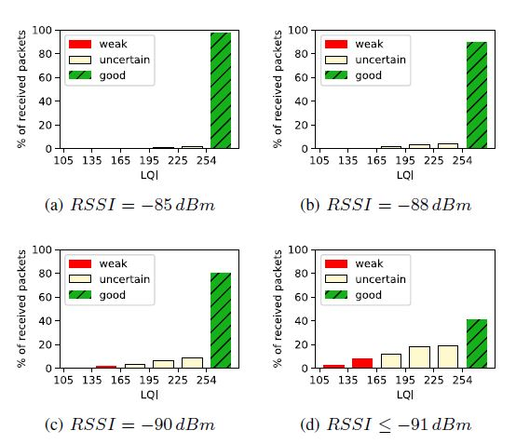
CLASSIFICATION OF LINKS BASED ON LQI
Distribution of LQI for a packet received with given RSSI. The rightmost bar is for LQI = 255 only, the other bars aggregate 30 consecutive values.

Slide 11
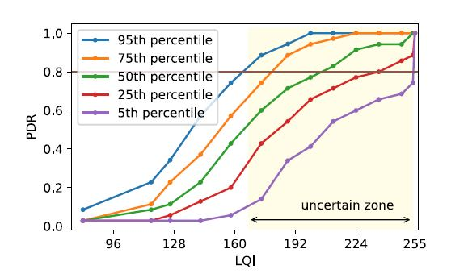
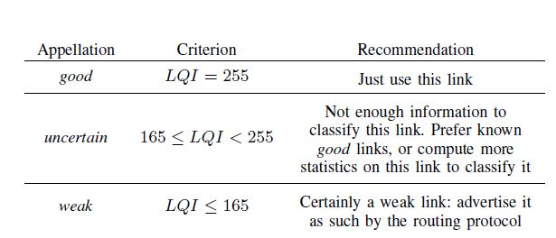
CLASSIFICATION OF LINKS BASED ON LQI
Considering that good links are those whose PDR > 80%, we can identify three zones.
The links that expose LQI = 255 can be considered as good without any doubt.
Where LQI ≤ 165, almost all links (more than 95%) are definitively weak.
Between these two limits, the links cannot be immediately classified as good or weak. To differentiate them, the node needs to dedicate more resources. These are called uncertain links

Slide 12
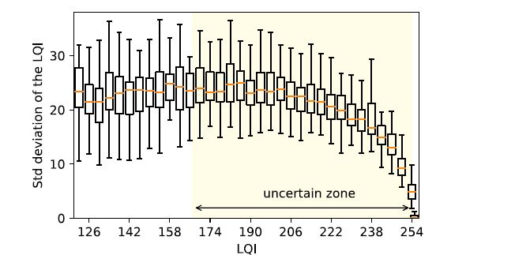
CLASSIFICATION OF LINKS BASED ON LQI
LQI is a relatively stable metric, though it may be sensitive to modifications of the environment
The extremely small variability illustrates how the good links are really stable even though their RSSI is low, which calls for giving them priority

Slide 13
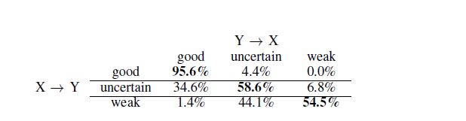
ENSURE REVERSE DIRECTION QUALITY
All three lines confirm that the symmetric case is the most frequent case. 95% of the good links are also good in the reverse direction.
The uncertain links perhaps require to dedicate more efforts to use them or not: more than one third is actually good in the other direction, which indicates a strong chance of acceptable PDR, however, they should be carefully checked

Slide 14
CONCLUSION
From LQI, most unidirectional links are immediately either usable or not. It is safer to first check that a good candidate link is also reliable in the reverse direction, which requires just a basic handshake.
Otherwise, a fraction of links requires more effort to be classified and the uncertainty can be sorted out through the exchange of a few additional packets.
We end up with a classification of the links in two categories: reliable and weak links, with the idea to avoid the latter as much as possible, only if they are necessary to maintain connectivity

